Slide 1


Cultural Awareness

Slide 2
Learning Objectives
The concept of microaggression
Cultural awareness/sensitivity
The impact of cultural borrowing
The concept of multicultural marketing
2

Slide 3
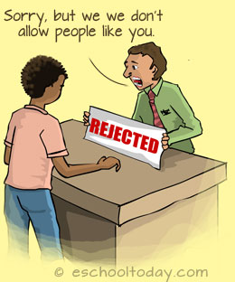
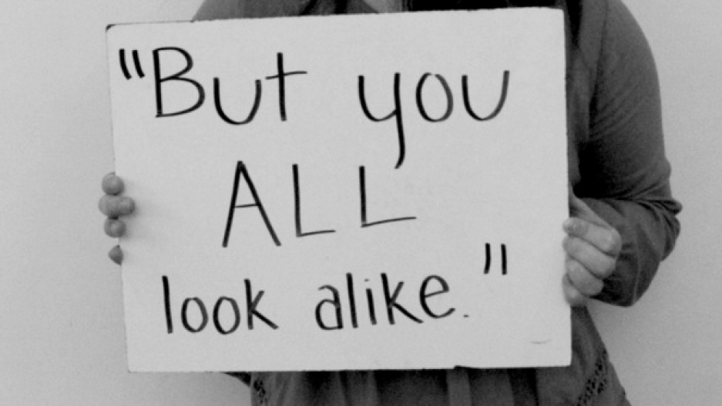
Microaggression
A subtle, often unintentional, but offensive comment or action directed at non-dominant groups
https://www.youtube.com/watch?v=BJL2P0JsAS4
Discrimination vs. Microaggression: Strong vs. Subtle.

Slide 4
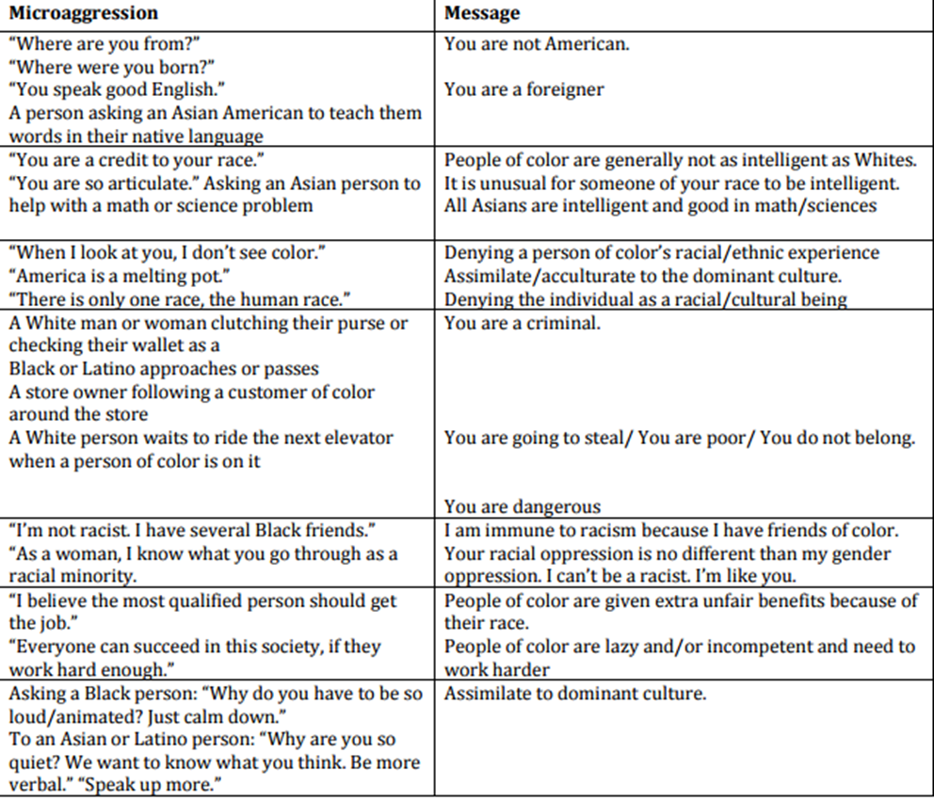

Slide 5
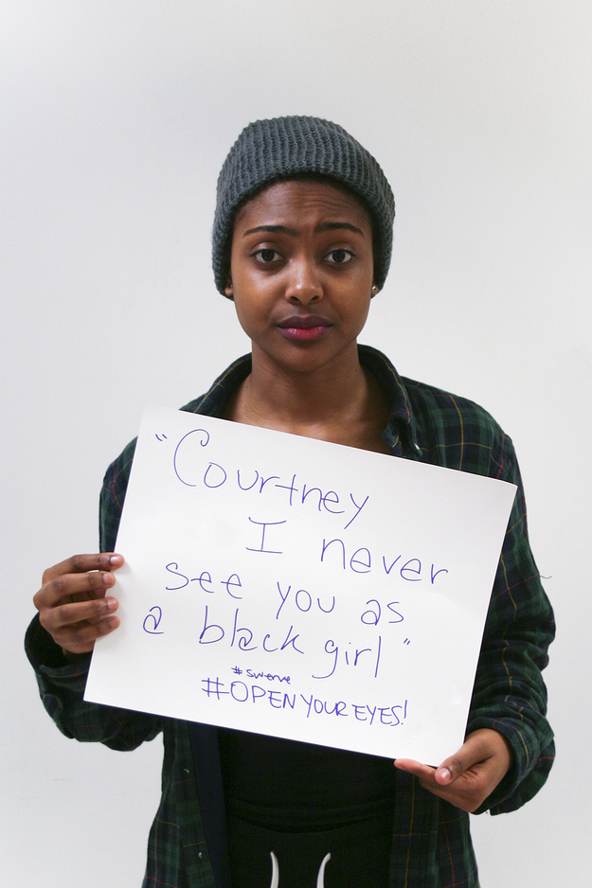
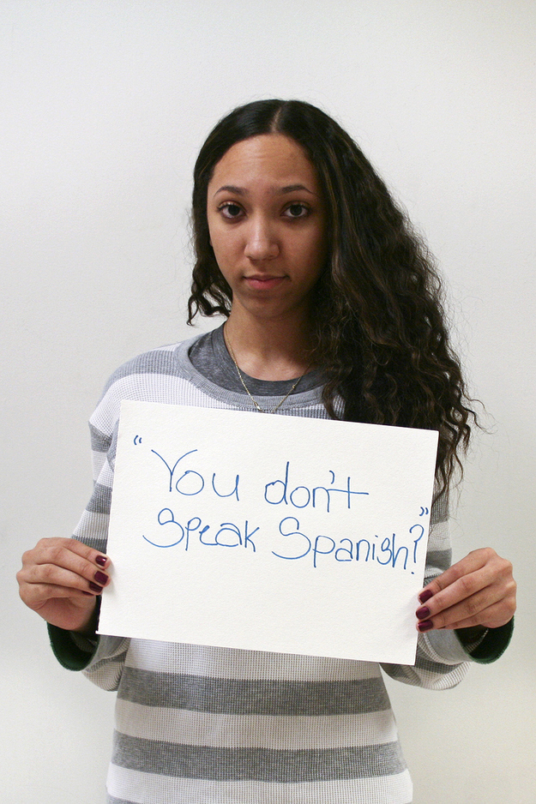

Slide 6
https://www.ispot.tv/ad/w0Fn/special-k-women-eat
Any issue with this commercial?
Notes:
Alternative link if the listed link on the page doesn’t work: https://www.refinery29.com/en-gb/2017/05/156201/special-k-women-eat-feminist-advert
This advertisement has received many criticisms. I would like you to critically think about the issues with it.

Slide 7
Microaggression: https://www.youtube.com/watch?v=bjzWENcW6NQ
  1. Microinsult: Communications that convey rudeness and insensitivity and demean a person’s heritage or identity.
  2. Microinvalidation: A form of microaggression that excludes or negates a person’s experience, thoughts, or feelings.
  3. Microassault: An explicit derogations that are meant to hurt the intended victim through name-calling, avoidant behavior, or purposeful discriminatory actions.

Slide 8
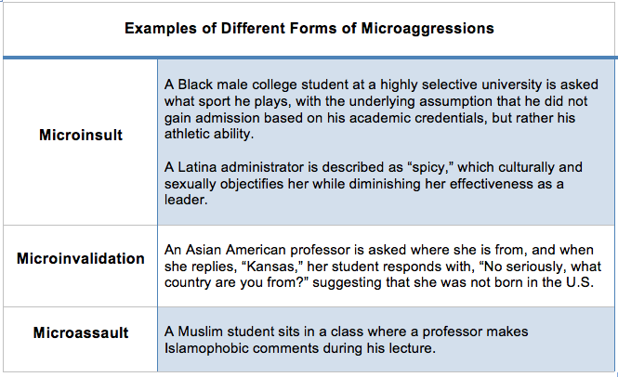

Slide 9

Cultural Awareness/Sensitivity
What is your score?
Cultural sensitivity: To what extent you are attuned to the nuances of culture so that a new culture can be viewed and evaluated less biased and appreciated. To what extent you think that a culture being different does not make it wrong.
Because a marketer is usually trying to introduce something completely new or to improve what is already in use, how cultures accept changes and the manner in which resistance to change occurs should be understood. The marketer also needs to understand the different wants and needs of different cultures.

Slide 10
Benefits of Cultural Awareness
Communicate respect and convey verbally and nonverbally a positive regard and sincere interest in people and their culture.
Display empathy by understanding other people's needs and differences from their point of view.
Remain nonjudgmental about the behavior of others, particularly with reference to one's own value standards.
Recognize and control self-reference criteria, that is, recognize their own culture and values as an influence on their perceptions, evaluations, and judgment in a situation.
Tolerate ambiguity and cope with cultural differences and the frustration that frequently develops when things are different.
Laugh things off- a good sense of humor helps when frustration levels rise and things do not work as planned.

Slide 11
Building Skills in Cultural Awareness
Increasing cultural and global knowledge.
Self-awareness: reflecting critically on our own biases and prejudices
Active listening
Empathy
Engagement
Notes:
Reference http://extensionpublications.unl.edu/assets/html/g1375/build/g1375.htm

Slide 12
Specific Ways to Increase Cultural Awareness
Understanding microaggressions.
Learning new languages.
  Opinions are mixed:
“The language of international business is English".
  "Modern English is the Walmart of languages: convenient, huge, hard to avoid, superficially friendly, and devouring all rivals in its eagerness to expand" .
“People expect to buy from marketers they can relate to, and who understand their language and culture". Some recruiters want candidates who speak at least one foreign language, because it is a strong signal that the candidate are willing to get involved in someone else's culture.
Notes:
Reference http://extensionpublications.unl.edu/assets/html/g1375/build/g1375.htm

Slide 13
Multicultural Marketing
Multicultural marketing is the practice of marketing to different ethnic groups in culturally diverse societies.
Why it is important:
  A country is often very diverse, both geographically and culturally. For example, marketing in the U.S. is complex because of its many subcultures.
  Each subculture’s traditions, languages, customs, and beliefs/norms influence how its members consume content, goods, and services.
Notes:
Understanding the subcultures of a country (a general market) is important because a subculture can have unique cultural dynamics that shape its members as consumers. For example, Caucasian Americans, African Americans, Hispanic and Latino Americans, and Asian Americans have different subcultures.
Having a cultural awareness is important due to globalization and (thereby) the cultural diversity within a country.

Slide 14
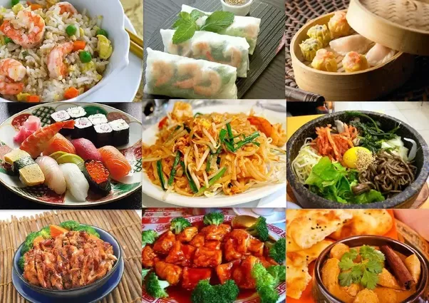
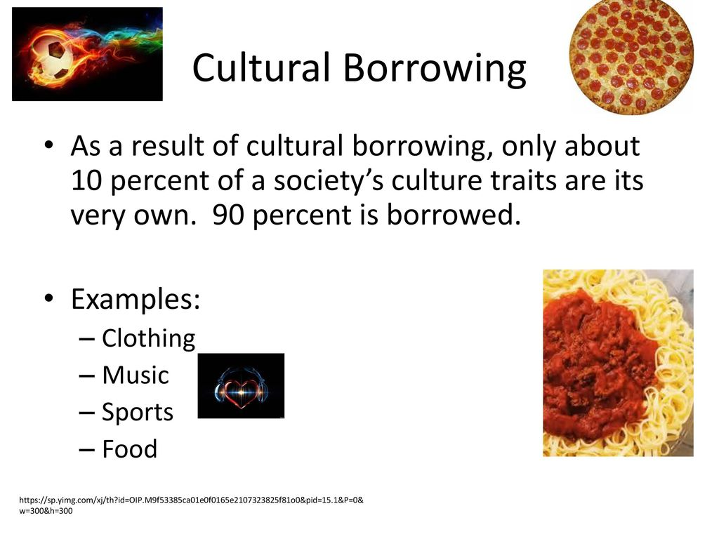
Cultural Borrowing
Cultural borrowing: A responsible effort to learn from others’ cultural ways in the quest for better solutions to a society’s particular problems.

Slide 15
Cultures constantly change.
Businesses and managers are constantly adjusting their efforts to cultural demands

Slide 16
Crossing Borders
After all, we are all humans. We have more similarities than differences:
Use metaphors
Have a system of status and roles
Are ethnocentric
Create art
Conceive of success and failure
Create group antagonistic to outsiders
Imitate outside influences
Resist outside influences
Consider aspects of sexuality private
Notes:
This class focuses on the cultural/subcultural differences. We study the differences to better understand why different countries/groups react differently to certain marketing stimuli so we can better predict and adapt to a market/segment.
But it is important to keep in mind that cultures/people always share much more similarities than differences. We study the differences to understand, NOT to stereotype or prioritize any specific culture/subculture.

Slide 17
End
Thanks!

